Slide 1
MySQL
서브쿼리

Slide 2
서브 쿼리란?
서브 쿼리란
하나의 SQL문 안에 포함되어있는 또 다른 SQL문을 말한다.

Slide 3
테이블 생성, 데이터 삽입
CREATE TABLE DAEGU_CITIZEN(
name varchar(20),
age int,
job varchar(20)
);

Slide 4
테이블 생성, 데이터 삽입
INSERT INTO DAEGU_CITIZEN(name,age,job) VALUES ('송중기', 33, '프로그래머');
INSERT INTO DAEGU_CITIZEN(name,age,job) VALUES ('이민호', 30, '회사원');
INSERT INTO DAEGU_CITIZEN(name,age,job) VALUES ('정채연', 23, '대학생');
INSERT INTO DAEGU_CITIZEN(name,age,job) VALUES ('박상민', 31, '학원강사');
INSERT INTO DAEGU_CITIZEN(name,age,job) VALUES ('안철수', 35, '프로그래머');
INSERT INTO DAEGU_CITIZEN(name,age,job) VALUES ('김민종', 33, '가수');

Slide 5
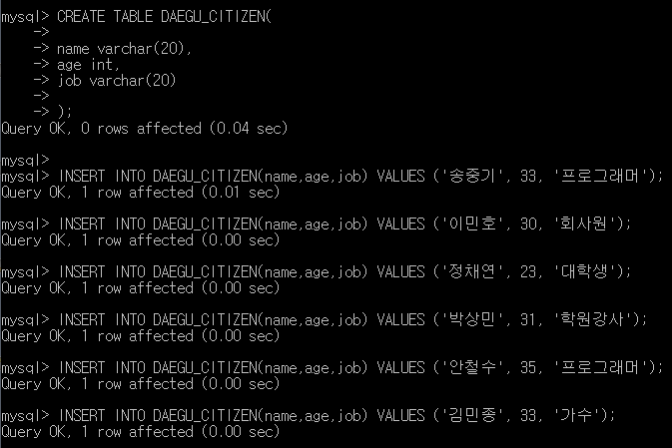

Slide 6
EX 1
select * from DAEGU_CITIZEN where JOB IN (select job from DAEGU_CITIZEN where name='송중기');
(송중기의 직업)
select * from DAEGU_CITIZEN where JOB IN(송중기의 직업);
송중기의 직업과 일치하는 직업을 가진 모든 사람을 출력

Slide 7
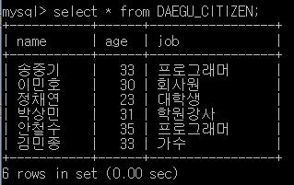
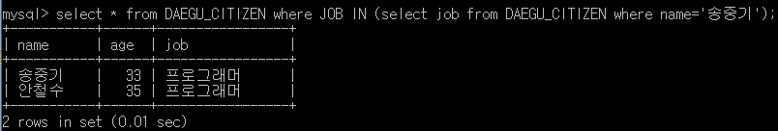

Slide 8
EX 2
select * from DAEGU_CITIZEN where AGE IN (select AGE from DAEGU_CITIZEN where name='송중기');
(송중기의 나이)
select * from DAEGU_CITIZEN where AGE IN (송중기의 나이);
송중기의 나이와 일치하는 모든 사람을 출력

Slide 9
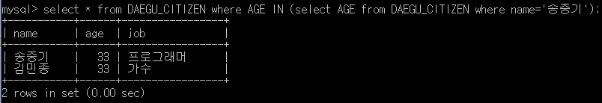

Slide 10
create table samyang_ramen(
name varchar(20),
produce_date date,
amount int(5)
);

Slide 11
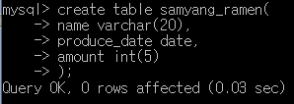

Slide 12
insert into samyang_ramen(name, produce_date, amount)
values('불닭볶음면' , NOW() , 5000 );
insert into samyang_ramen(name, produce_date, amount)
values('핵불닭볶음면' , NOW() , 6500 );
insert into samyang_ramen(name, produce_date, amount)
values('까르보불닭' , '2020-05-18' , 900 );
insert into samyang_ramen(name, produce_date, amount)
values('삼양라면' , '2020-05-18' , 5000 );
insert into samyang_ramen(name, produce_date, amount)
values('맛있는라면' , '2020-04-18' , 4000 );
insert into samyang_ramen(name, produce_date, amount)
values('갓짬뽕' , '2020-04-18' , 3000 );
insert into samyang_ramen(name, produce_date, amount)
values('갓짜장' , '2020-04-18' , 3000 );

Slide 13
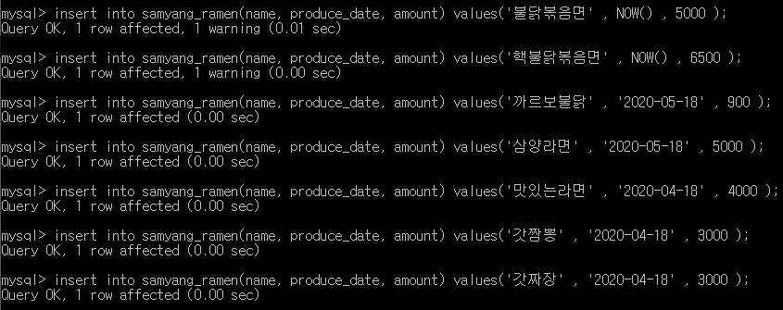

Slide 14
EX 3
select * from samyang_ramen where amount IN (select AMOUNT from samyang_ramen where name='불닭볶음면');
select * from samyang_ramen where amount IN (불닭볶음면의 생산량);
불닭볶음면과 생산량이 같은 라면은?

Slide 15
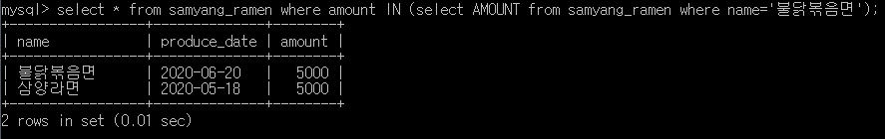

Slide 16
EX 4
select * from samyang_ramen where PRODUCE_DATE IN (select PRODUCE_DATE from samyang_ramen where name='맛있는라면');
select * from samyang_ramen where PRODUCE_DATE IN (맛있는라면의 생산량);
맛있는라면과 생산날짜가 똑같은 라면은?

Slide 17
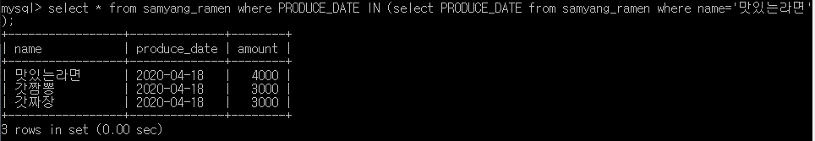

Slide 18
EX 5
송중기의 직급과 같은 직급을 가진 사원을 모두 출력

Slide 19
CREATE TABLE EMPLOYEE(
company varchar(10),
name varchar(10),
my_rank varchar(10)
);

Slide 20
INSERT INTO EMPLOYEE(company, name, my_rank) VALUES(‘삼성’, ‘송중기’ , ‘대리’ );
INSERT INTO EMPLOYEE VALUES(‘삼성’, ‘정채연’ , ‘대리’ );
INSERT INTO EMPLOYEE VALUES(‘삼성’, ‘이민호’ , ‘대리’ );
INSERT INTO EMPLOYEE VALUES(‘삼성’, ‘신동엽’ , ‘과장’ );
INSERT INTO EMPLOYEE VALUES(‘삼성’, ‘김사랑’ , ‘과장’ );
INSERT INTO EMPLOYEE VALUES(‘삼성’, ‘이재용’ , ‘부사장’ );
Notes:
INSERT INTO EMPLOYEE VALUES(‘삼성’, ‘송중기’ , ‘대리’ );
INSERT INTO EMPLOYEE VALUES(‘삼성’, ‘정채연’ , ‘대리’ );
INSERT INTO EMPLOYEE VALUES(‘삼성’, ‘이민호’ , ‘대리’ );
INSERT INTO EMPLOYEE VALUES(‘삼성’, ‘신동엽’ , ‘과장’ );
INSERT INTO EMPLOYEE VALUES(‘삼성’, ‘김사랑’ , ‘과장’ );
INSERT INTO EMPLOYEE VALUES(‘삼성’, ‘이재용’ , ‘부사장’ );

Slide 21
SELECT * FROM EMPLOYEE WHERE RANK = (SELECT RANK FROM EMPLOYEE WHERE NAME=‘송중기’ );

Slide 22
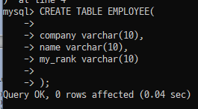
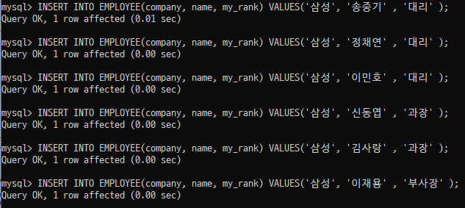

Slide 23
